Slide 1
SoundGood Music School Database System
Casper Kristiansson, casperkr@kth.se

Slide 2
Introduction
01.
02.
Conceptual Model
Logic Model
03.
04.
SQL Queries
Programmatic Access
Constructing a conceptual model
Constructing a logic model & creating the database
Creating and performing different types of SQL queries
Creating a program to access parts of database

Slide 3
Part
Each part will consist of three things:
What was the goal?
How did I solve it?
What conclusion could I draw?

Slide 4
01.
Conceptual Model
Constructing a conceptual model

Slide 5
Goal
The goal of this task is to create a conceptual model for a music school. The model was created by using the modelling program Astah. The model itself consist of an ER diagram (Entity-relationship model). Designing a conceptual model consist of five steps:
Noun Identification
Category lists
Remove unnecessary entities
Find attributes
Find relations

Slide 6
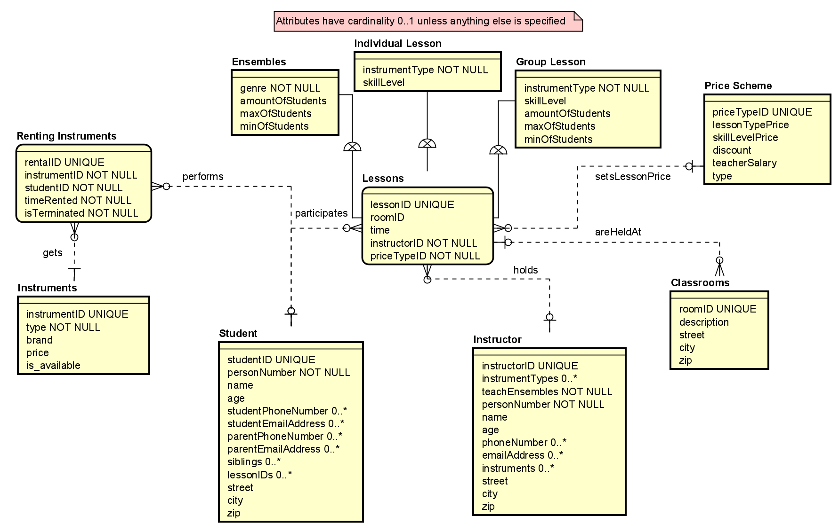
Result
The conceptual model main structure is built around “Student” and “Instructor” entity. The “Lessons” entity is used for inheritance for each of the lesson types (“Ensembles”, “Individual Lessons”, “Group Lessons”).

Slide 7
Conclusion
Inheritence
Business Rules
General Design

Slide 8
02.
Logic Model
Constructing a logic model & creating the database

Slide 9
Goal
The next task of the project is to create a logical or a Physical model from the conceptual model that was created in the previous task. Converting a conceptual model to a logical model consist of six steps:
Deciding which relations should be kept
Specifying column types
Adding column constraints
Making sure that the model is normalized and that all different database operations can be performed on the model
Specifying the different attributes
Relations (many-to-many, one-to-many)

Slide 10
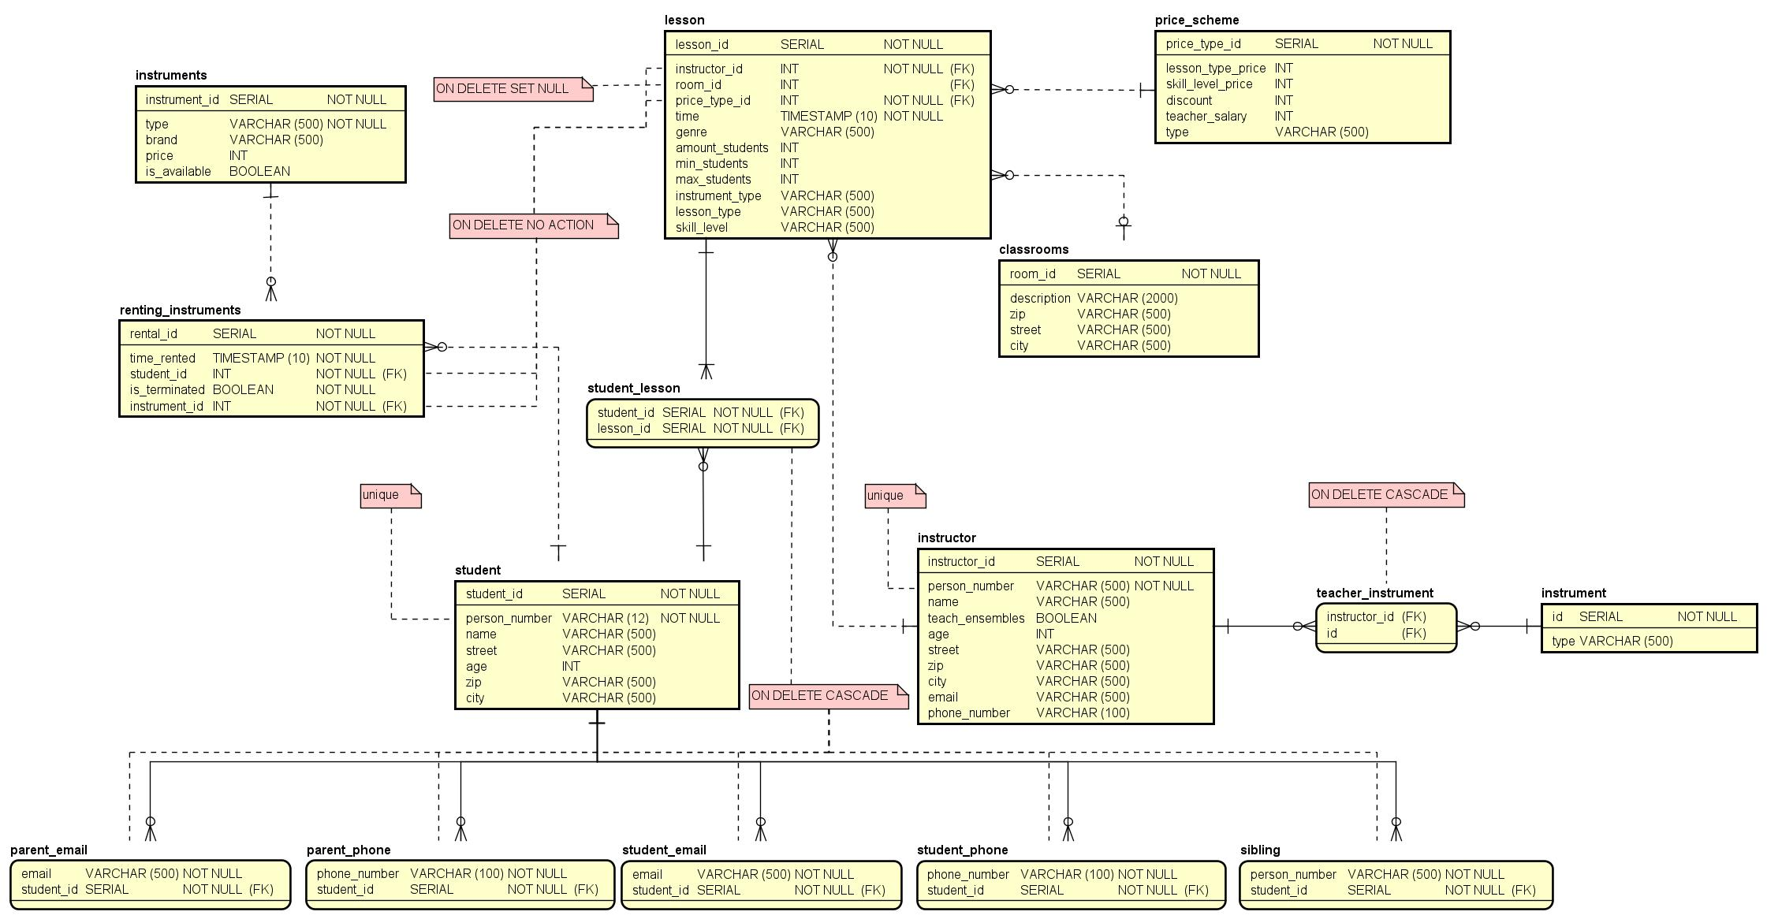
Result
In the figure it can be seen that it follows the same structure as task one where it focuses on the student and instructor. I created the required many-to-many relations for example student-lesson for which consist of all the different lessons a student is signed up

Slide 11
Conclusion
3NF
Constraints
Business Rules
Solution
model consisted of couple of flaws
avoid duplicate data, avoid data anomalies, simply management of data
column constraints and foreign key constraints
Working with inheritance

Slide 12
03.
SQL Queries
Creating and performing different types of SQL queries

Slide 13
Goal
Lesson Per Year
Lesson Type Per Month
Average Lessons Per Month
Instructor Count
Next Week Lessons
The next task of the project was to create SQL queries to manage different tasks that will be performed on the data in the database. Those queries include:
Average number of lessons for each month
Number of lessons per month during a specific year
Number of different lesson types per month
Count the number of lessons different instructors has given
The Upcoming week ensemble lessons

Slide 14
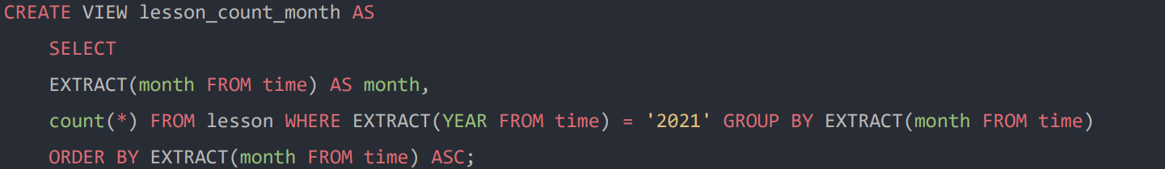
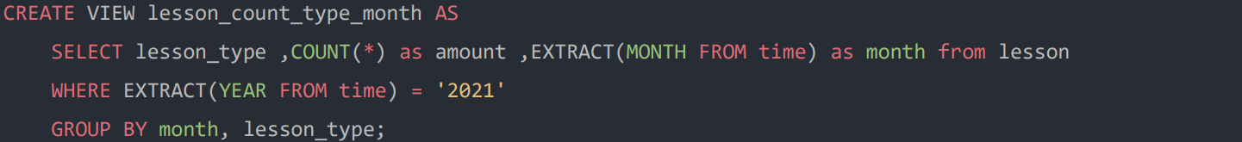
Result
The first query that was created was the view for counting the number of lessons given per month during a year. By using the group command is used to arrange the data into groups by its month to match the EXTRACT (month FROM time)
The next goal is to create a view for the number of different lessons that exists each month during a specific year. This can be achieved using the COUNT(*) command and group them using MONTH by using the EXTRACT command.

Slide 15
Conclusion
Materialized View vs “Normal” View
The substantial difference between a view and a materialized view is that a view is a logical virtual copy of a table while a materialized view is stored on the disk, it is a physical copy of a table. Because of this a “normal” view will have slower processing speed while a materialized view will have faster processing speed. A downside to materialized view is that it requires memory space while a view does not.

Slide 16
04.
Programmatic Access
Creating a program to access parts of database

Slide 17
Goal
Database Connection
Prepare Statements
MVC Design Pattern
Creating a database connection
Setting up SQL prepare statements (queries)
Building the structure for the MVC design pattern

Slide 18
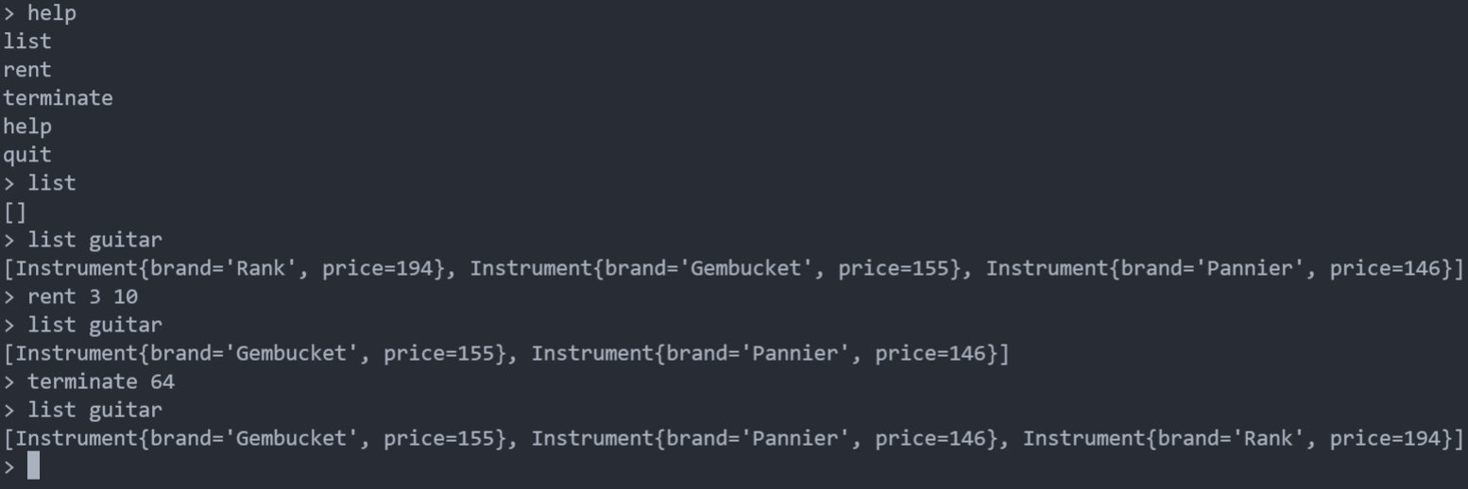
Result
A sample printout of the program can be seen. It shows all the different commands that can be executed. That includes listing all commands, listing all instruments, renting, and terminating a rental

Slide 19
Conclusion
Atomicity
Consistency
Isolation
Durability
ACID Transactions

Slide 20
By following the different sub tasks the author was able to structurally design a database which can manage all the different business goals. Even when designing the database in the structurally way I still needed to go back to the first/second task and redesign the Conceptual Model and Logical Model.

Slide 21

Thanks !
Any Questions?

